Slide 1
21st Century Truck TARDEC Fall Meeting
Active Safety Systems - Road to Autonomous Functionality
Alan Korn
Director-Advanced Brake System Integration
November 6, 2013

Slide 2
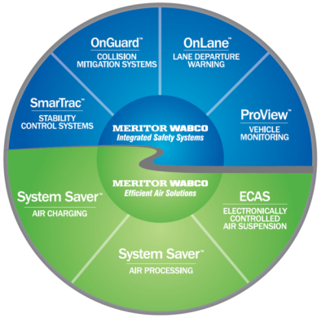
Presentation Overview
Meritor WABCO Background
Heavy Truck Crash Facts
NHTSA Automation Classifications
Today’s Active Safety System Technology
  ABS, Stability Control, Collision Mitigation, LDW,
Future Active Safety System Technologies
  Advanced CMS, Driver/Vehicle Performance Management, V2V, CACC
  Increased automation
11/06/13

Slide 3




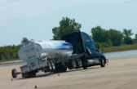
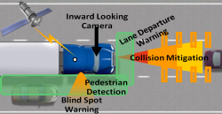
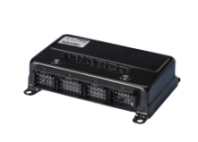
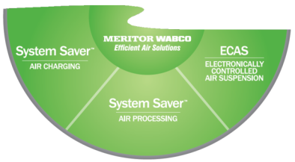
LONG RANGE RADARS
ACC
FCW
CMS
CAMERA BASED LANE TRACKING SYSTEM
Driver Alertness Warning
LDW
SAFETY SYSTEM DATA MANAGEMENT
Driver Monitoring
Data Analytics
ABS ECU’s
Hydraulic
RSS
RSC
ESC
ESC ^{SMART}
Safety Strong
Efficiency Smart
A leader in Advanced Integrated Safety Systems
Focused on improving performance and handling, assisting the driver in maintaining control of the vehicle and avoiding accidents
Continued commitment to safety systems capable of reducing commercial vehicle accidents
11/06/13

Slide 4
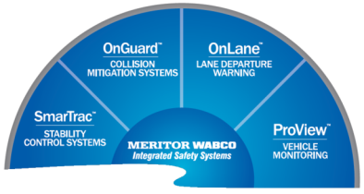
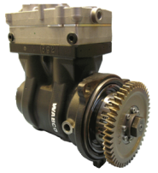
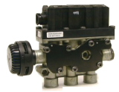
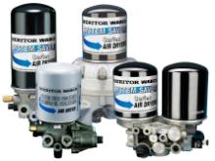
Efficient Air Solutions are engineered for optimized performance with less energy consumption.
Intelligent Air System innovations providing:
  Enhanced efficiency, performance and reliability
  Reduced maintenance and operation costs
Reduced product weight providing:
  Increased payload capabilities
  Further fuel savings
Efficiency Smart
AIR COMPRESSORS
Hi Output
Twin
Clutch
SUSPENSION CONTROLS
  ECAS
  Leveling Valves
AIR DRYERS
•1200 Plus •ECAD •1200 Regen •Twin
11/06/13

Slide 5
2011 US Large Truck Crash Statistics
287,000 large truck DOT reported crashes
3,608 trucks involved in fatal crashes
3,757 fatalities - 635 truck occupants
  2.2% increase in total fatalities over 2010
  71% combination vehicles
88,000 injuries - 23,000 truck occupants
Fatalities / 100 million miles traveled 1.41 (+10% from 2010)
  45% reduction from 2000
Alcohol involved in 3.0% of large truck fatal crashes
  Alcohol involved in 27% of passenger car fatal crashes
Ref: 32,367 fatalities from all US motor vehicle crashes
  1.5% fatality reduction over 2010
  1.10 Fatalities / 100 million miles traveled
11/06/13
5

Slide 6
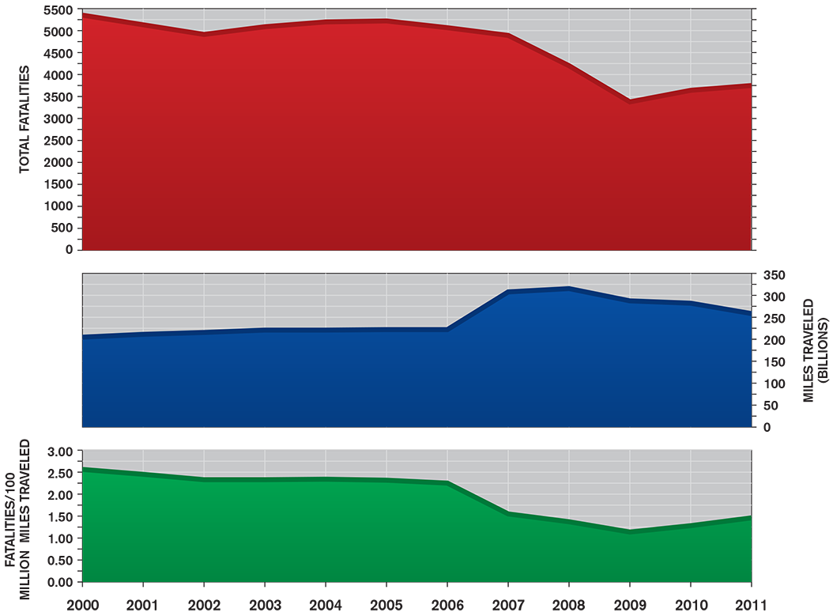
Large Truck Fatal Crashes 2000-2011
11/06/13

Slide 7
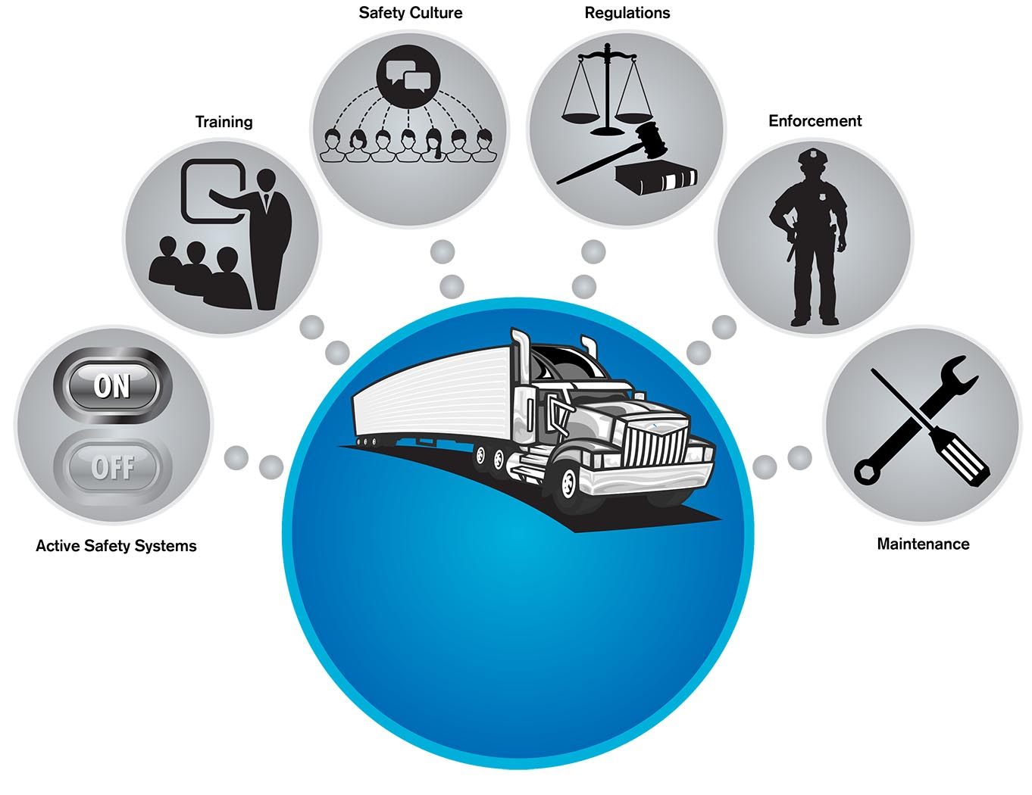
Elements Driving
Safety Improvement
Driving Safety
Improvement
11/06/13

Slide 8
NHTSA Levels of Automation
Level 0: Driver in complete & sole control of vehicle; braking, steering, throttle
Level 1 Function Specific: One or more systems that automatically assists driver with a primary vehicle control function
Level 2 Combined Function: Two or more primary control functions combined to work in unison to relieve driver of control of these functions
Level 3 Limited Self Driving: Enable driver to cede full control under certain conditions. When necessary, system automatically transitions control back to driver
Level 4 Full Self Driving
Today’s well equipped large trucks are at Level 1
11/06/13

Slide 9
Current Active Safety Systems
System designed to ASSIST driver in maintaining control of vehicle and reducing crash risk
  Driver remains responsible for safe operation of vehicle and ensuring physical limitations are not exceeded
Contains onboard sensors, actuators and intelligent algorithms to enable automatic intervention of one or more of the vehicle’s primary control functions when safety thresholds are exceeded – braking, steering, throttle
Examples include ABS, Stability Control, Collision Mitigation and Lane Departure Warning
11/06/13

Slide 10
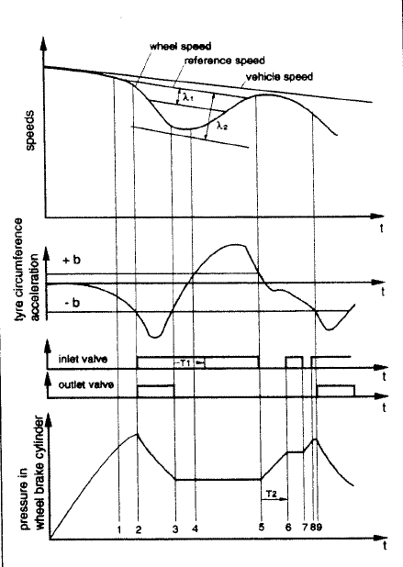
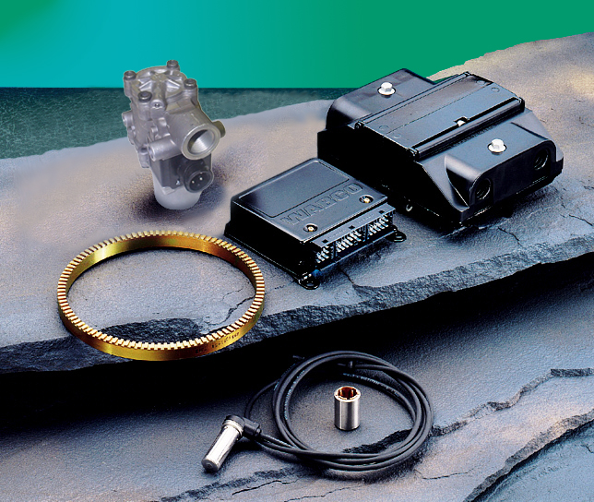
Antilock Braking System (ABS)
Foundation for advanced safety systems
Helps prevent high levels of wheel slip
(wheel lock) during braking
  Typically occurs on slippery road surfaces,
  light vehicle loads, worn tires
  Wheel lock adversely effects vehicle’s
  lateral stability (jackknife), ability to
  steer and stopping distances
11/06/13

Slide 11
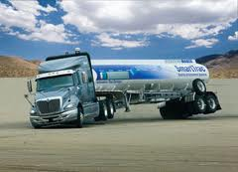
Electronic Stability Control
Closely integrated with ABS
Additional sensors, control valves and software required for increased functionality
  Steer angle, pressure sensor, yaw rate, lateral accelerometer, three brake control valves
  Architecture required for CMS
Reduces risk of untripped rollovers
  Excessive speed in turn, rapid changes of direction on high friction surfaces
Reduced risk of loss of control
  Understeer and oversteer conditions typically on lower friction surfaces
11/06/13
11

Slide 12
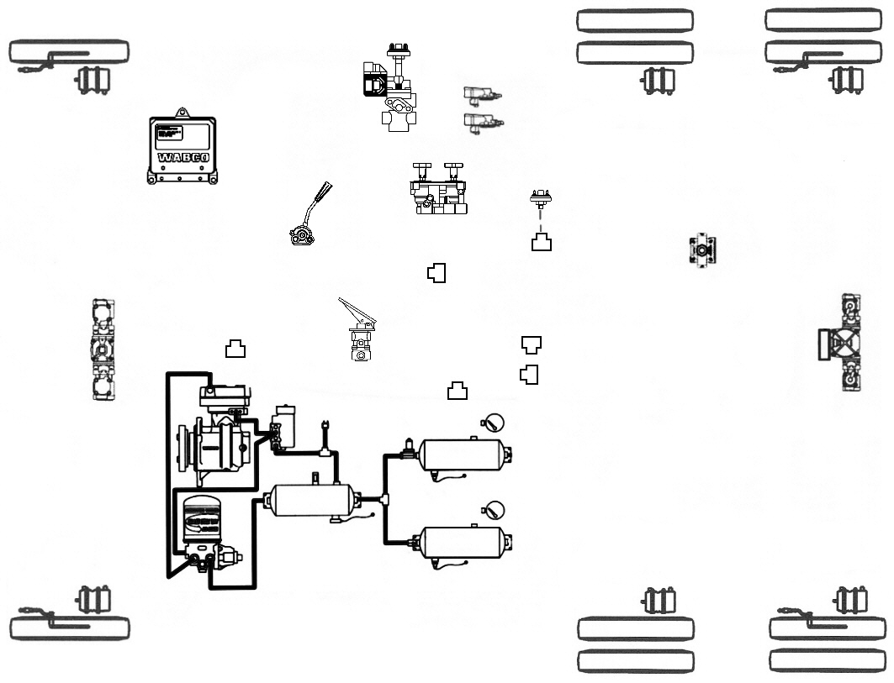
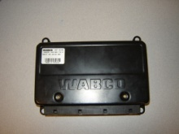
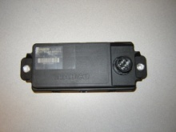
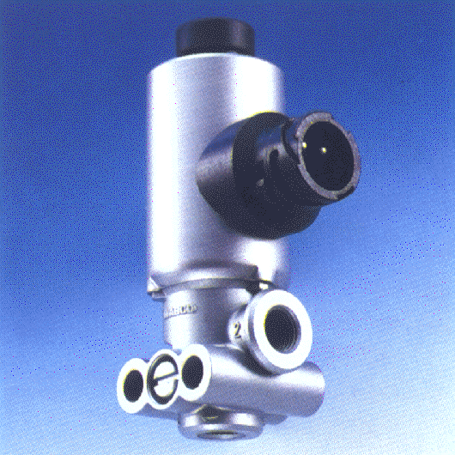
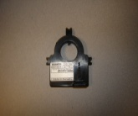
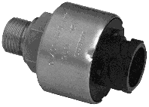


Tractor ABS + Electronic Stability Control (ESC)
COLOR KEY
Primary
Secondary
Park & Emergency
Blended Air
Supply
Electrical Wire
11/06/13
12

Slide 13
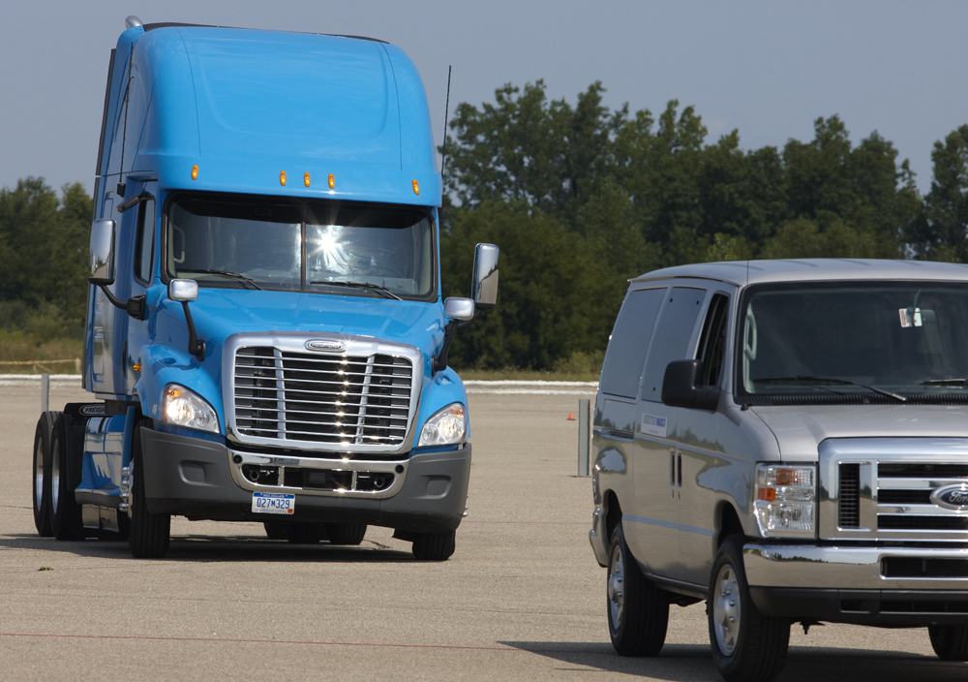
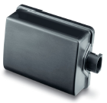
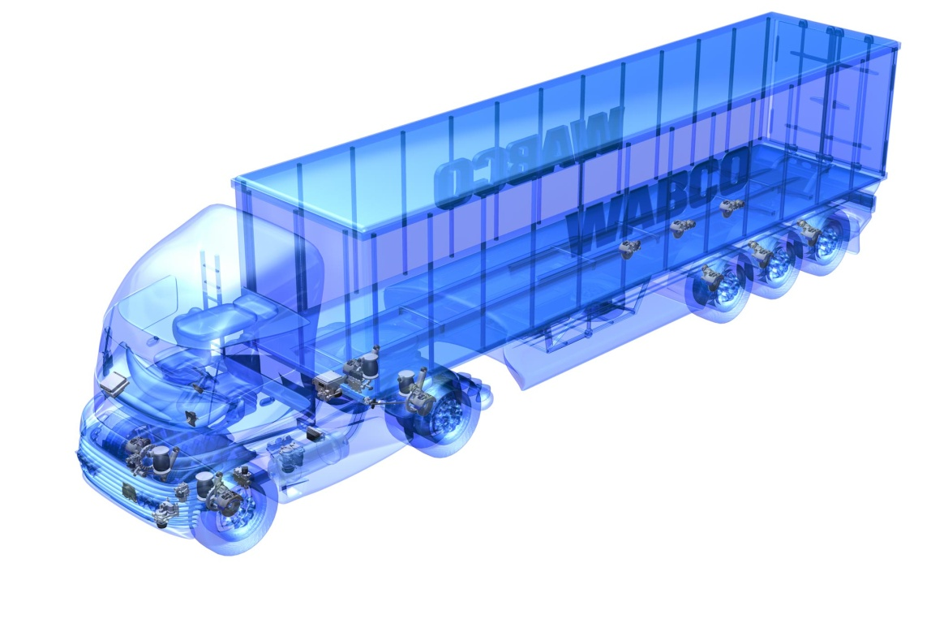
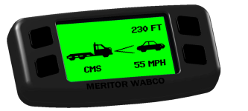
Collision Mitigation
Braking System (CMS)
Active braking system designed to reduce / mitigate forward collisions
Based on single radar sensor
Collision, stationary and haptic warnings
Adaptive cruise control and ‘always on’ collision mitigation
  Active braking
Integrated w/ABS and stability control
11/06/13

Slide 14
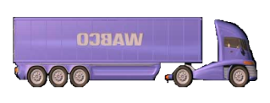
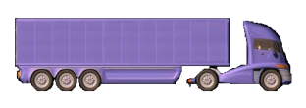

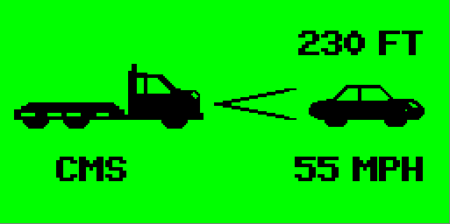
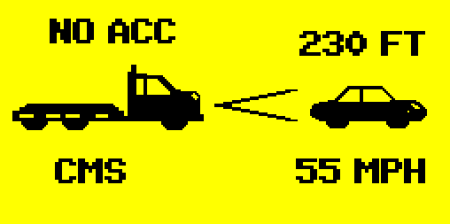




CMS Intervention Sequence
Hard braking required to prevent collision
Potential rear end collision detected
Avoidance maneuver not possible
t0
t1
t2
t3
t4
time
Object tracked
Distance Alert: Visual and Audible
Collision warning: Haptic
(short brake pulse)
Automatic braking to assist driver in collision mitigation
Crash prevented or mitigated
FT
FT
FT
MPH
MPH
MPH
Warning Tone and Lamp
System Reactions:
Engine Torque Limitation
Haptic Warning
Brake Activation
11/06/13
14

Slide 15
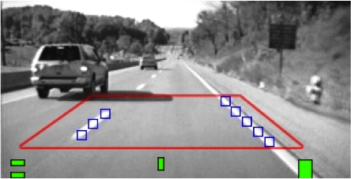
Lane Departure Warning
Vision based technology
Detects and classifies lane markers
Tracks and projects lane ahead of truck
Provides audible warnings
  Lane change made without turn signal indicator (rumble strip warning)
  Functions above 40 MPH
Includes Driver Alertness Warning
  Detection of erratic or degraded driving (drowsiness and/or distraction)
  Software solution requires no additional hardware
Automatic calibration and integrated diagnostics to simplify setup and operation
SAE J 1939 critical event messages
Integrated critical event video with manual download capability
800+ Million miles on North American applications
11/06/13

Slide 16

Near Term Future
Active Safety Systems
Level One Automation
Next Generation ABS, stability control, CMS
Driver/Vehicle Performance Management
Vehicle Communications
  V2V / V2I
  Cooperative ACC Project
Maximize driver performance by providing support technologies that warn and intervene at critical moments
11/06/13

Slide 17
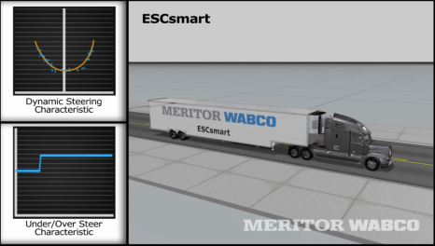
ESC Smart Technology
Employs vehicle model to predict stable path
Establishes vehicle dynamic characteristics by self learning and adaptation
  System continually adapts
  to changes in vehicle’s response
  characteristics
  “Drive it Away” off OEM assembly line
Minimize vehicle validation test requirements
Globally used across all braking platforms
Competitive ESC platform for non standard
vehicle configurations
Efficient throughout vehicle life cycle
11/06/13

Slide 18



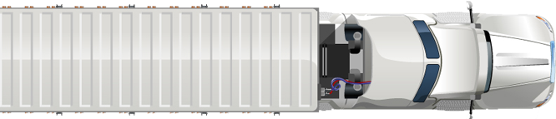
CMS Future Roadmap
+
Auto alignment
Dual mode radar
Warning on stationary objects
Evasive maneuver check
Partial braking on stationery objects
Full braking capability on moving
or stopped objects
Extended brake assist
In-crash braking
Full braking of stationary objects
Sensor fusion
ACC Stop & Go
Brake pre-fill
Autonomous Emergency Braking
Current
2014
2016
Continuously upgrading and pioneering innovation to enhance safety
11/06/13
Notes:
18

Slide 19
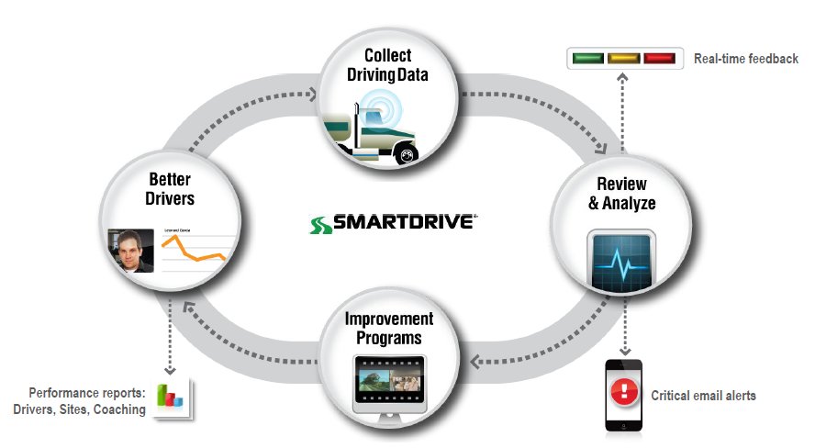
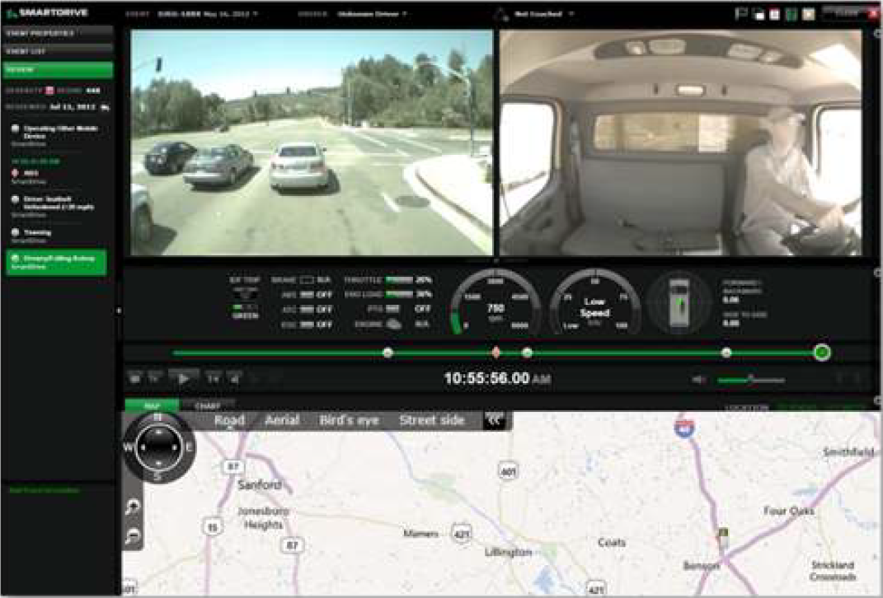
Driver / Vehicle Performance Management
Using predictive analytics to detect driving maneuvers that increase crash risk
High use of forward and inboard facing video to achieve driving optimization
Documented feedback striving for self improvement
Vehicle monitoring for predictive maintenance
11/06/13

Slide 20
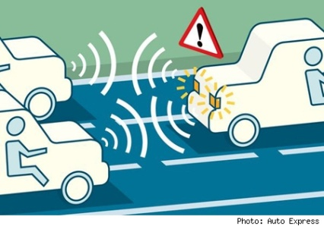
V2V / V2I Communications
Dynamic wireless exchange of data between vehicles and infrastructure (5.9 GHz DSRC)
All vehicles on public roads broadcast data regarding position, speed and location
  “Here I Am” data messages
Vehicles sense threats with 360 degree awareness
Estimated to address over 75% of unimpaired crash scenarios
System only provides warnings
Provides traffic stream data that must be integrated with current vehicle based active safety systems
  Can not have two systems providing similar warnings
    On-board CMS, Blindspot detection
11/06/13
20

Slide 21
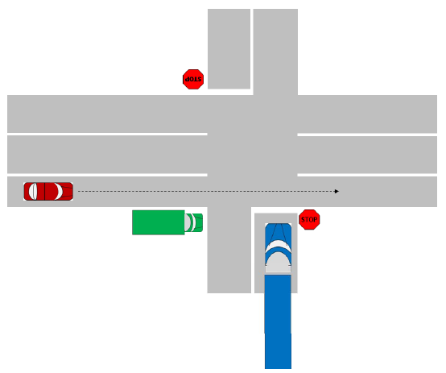
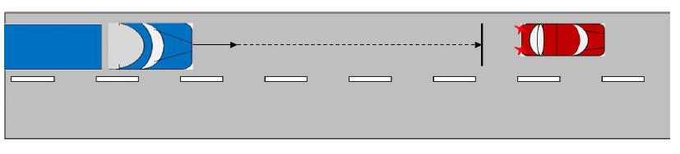
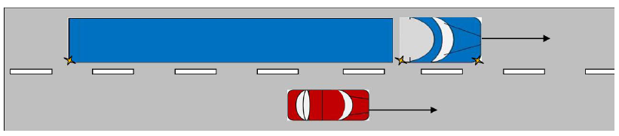
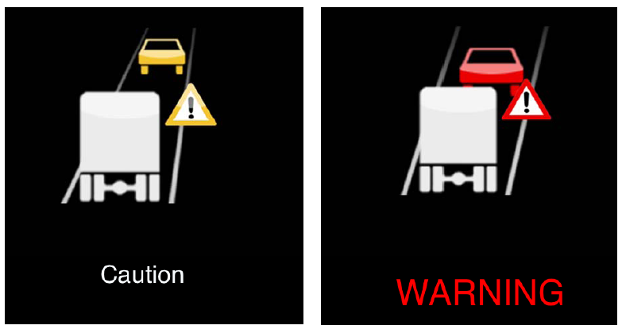
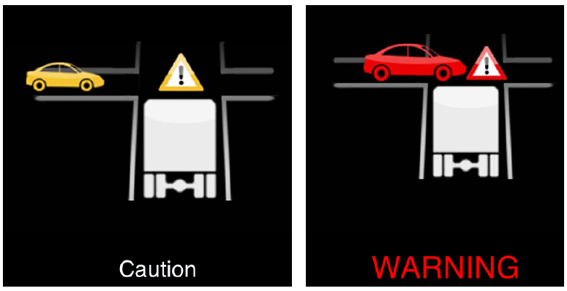
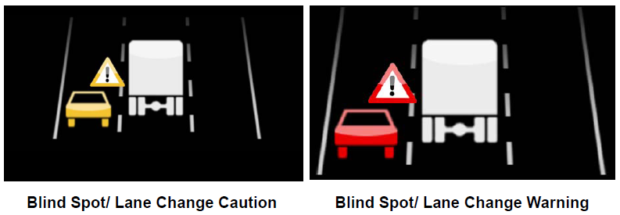
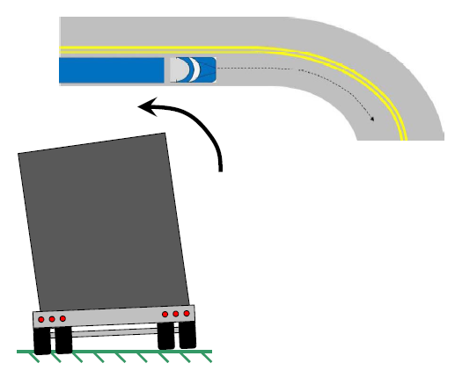
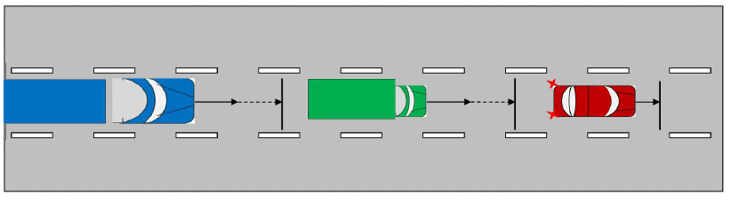
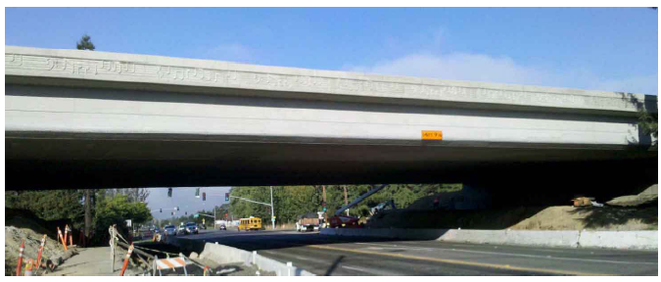
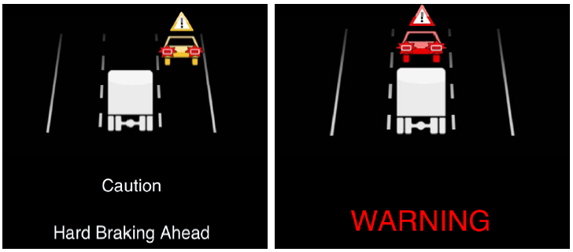
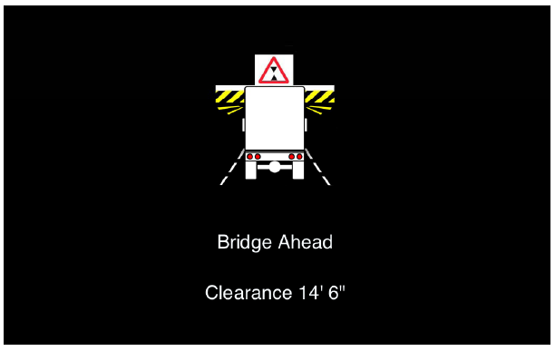

V2V/V2I Warnings
Intersection Movement Assist
Forward Collision
Blind Spot
Hard Braking
Bridge Height
Curve Speed
11/06/13

Slide 22
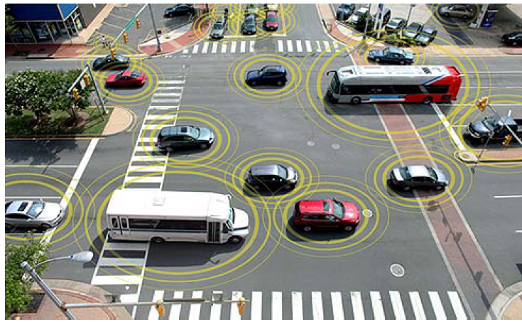
V2V / V2I Safety Pilot
Field test of technology running in Ann Arbor, MI
  Initiated August 2012
Designed to determine effectiveness of technology in reducing crashes and how drivers respond to applications
Approx 3,000 vehicles, 70 trucks
NHTSA recently announced pilot will be extended 6 months until February 2014
GAO recently released a report summarizing V2V status and potential benefits
11/06/13

Slide 23
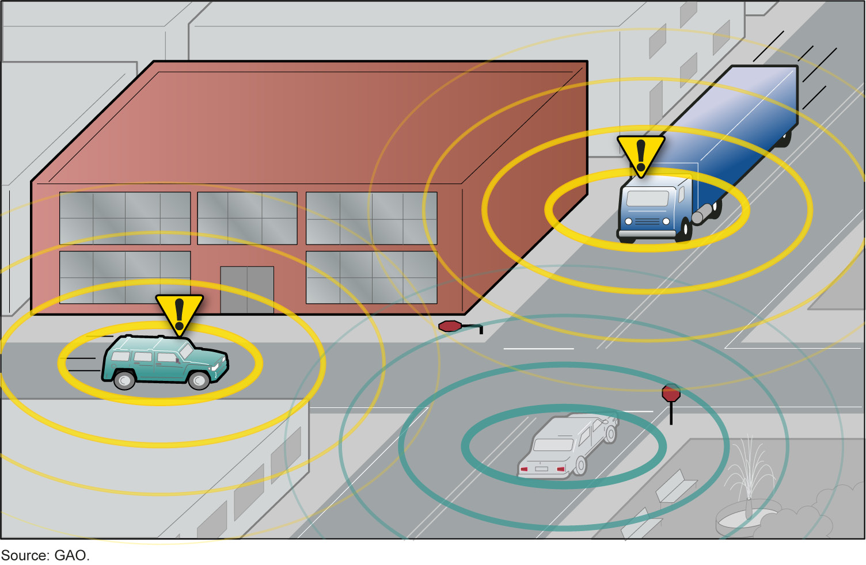
Vehicle 2 Vehicle
CV Communication Challenges
Trailer presence and length needs to be considered
  How to automatically supply this data to tractor installed devise
Articulated vehicles present additional challenges
  Intersection clearance, lane changes
Security of messages must be assured
Can payback be ensured during the initial years of deployment?
Will regulation be required to achieve adequate penetration rate for payback (light and heavy vehicles)?
Heavy truck regulatory decision scheduled for 2014 (pass cars 2013)
11/06/13
23

Slide 24

Cooperative Adaptive
Cruise Control Project
Federal Highway (FHWA) awarded project in early October to team led by Auburn University
  Peloton, ATRI, Peterbilt, Meritor WABCO
Team will research Partial Automation for two Truck Platooning
  Cooperative Adaptive Cruise Control builds off current Adaptive Cruise Control
  Key technologies include radar, V2V communications, positioning, actuation and Human-Machine Interfaces (transmitting critical information to leading and following drivers)
11/06/13

Slide 25

Key Research Tasks
Document traffic flow and fuel economy improvement potentials
System robustness
System reaction to passenger car cut-ins and other highway anomalies
How to find similarly equipped vehicles
Responsibilities of lead driver
Return on investment
11/06/13

Slide 26
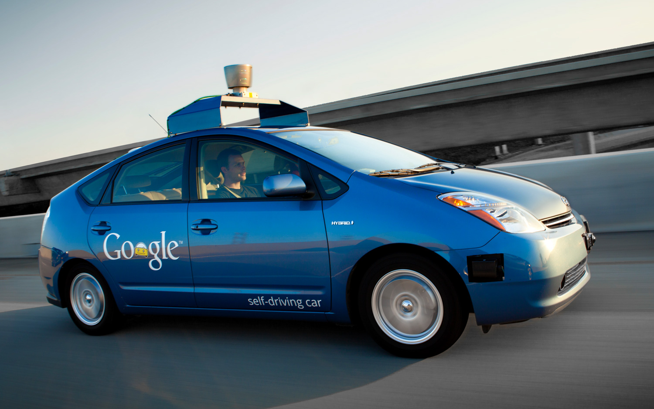
Challenges Moving to Advanced Automation Levels
Achieving sufficient technology payback technology
  Especially Levels 2 & 3
Validation requirements
Potential reduction in driver skills
Transition from complete system control back to driver – Level 3
  Will driver be prepared?
Liability concerns
Infrastructure improvements
Mixed vehicle population
11/06/13

Slide 27
Next Steps in Autonomous Functionality
Adaptive vehicle based safety systems
  Integrating traffic stream, environment & infrastructure information
Continued development in higher performance sensors and actuators, cost optimized for volume production
Higher software reliability levels and tools to validate
Cybersecurity
11/06/13

Slide 28
Summary
Use of heavy truck active safety systems increasing
  ABS (mandated)
  Stability control – approx 50% of class 8 tractor build
    Notice of Proposed Rulemaking Issued May 2012
  Collision Mitigation – approx 10% of class 8 tractor build
    Rulemaking being seriously considered
Changes in automation level will be evolutionary, not revolutionary
For the near term, active safety systems will assist drivers, not replace them
11/06/13

Slide 29
Save Lives, Increase Value, Reduce Costs
Cutting edge
“There’s a way to do it better – find it.”
Thomas Edison
Inventive
Trendsetting
Thanks!
Novel
Groundbreaking
Alan Korn
Alan.Korn@meritorwabco.com
001 248 435 4498
29

