Slide 1


Electrifying and Microgridding Transportation Systems
A Natural Pairing

Slide 2
Agenda
Moderator: David Jones (ICF) Manager, Energy Markets and Distributed Resources
Speakers:
Steve Pullins (AlphaStruxure) Chief Technology Officer
Mike Walton (Burns Engineering, Inc.) Director Advanced Power Systems
Kevin Self (Schneider Electric) Business Development & Government Affairs
Resources:
Speaker Bios
Ask the Experts: Q&A at End
Microgrid Resources Library
2

Slide 3

1) Transformational Microgrids at Major US Transit Hubs
Steve Pullins, AlphaStruxure – a Carlyle Group and Schneider Electric Company, Chief Technology Officer
Challenges:
Sustainability
Reliability & resilience
Predictable & competitive costs
…massive need for a transformational solution
Enabling the Airport of the Future
3

Slide 4
Solutions
Options space – led by the customer’s objectives
Energy as a Service – an innovative enabling business model
Key – innovative solar + storage + baseload generation+ eGSE¹ charging approach paired with offsite renewables
  Islanding capabilities with on-site resources & advanced controls
  Real-time optimization through end-to-end digitization
1. eGSE: Electric Ground Support Equipment
Speaker: Steve Pullins, AlphaStruxure
4

Slide 5
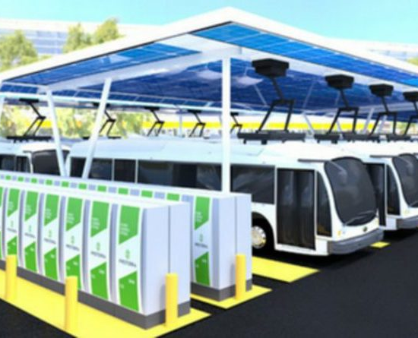
Results
Exceeding our client’s sustainability objectives
Stable & affordable power that eliminates economic loss from outages
  Reliability
  Resilience
As-a-Service means a transformative outcome with risk transfer to EaaS partner and no upfront cost
Electrifying Transportation
Speaker: Steve Pullins, AlphaStruxure
5

Slide 6
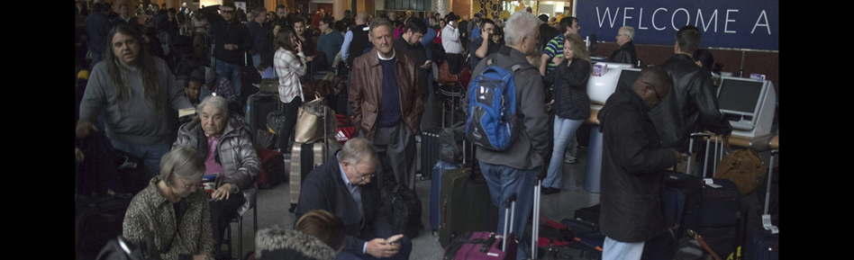
Why Airports are Ideal Locations for Resilient Microgrids
Mike Walton, Burns Engineering, Director
Atlanta Hartsfield-Jackson Airport Power Outage December 2017
Cost Delta Air Lines ~$25 million to $50 million
Delta canceled about 1,400 flights
The world’s largest airport, with 100 million passengers per year
Took airlines several days to resume their normal schedules
6

Slide 7
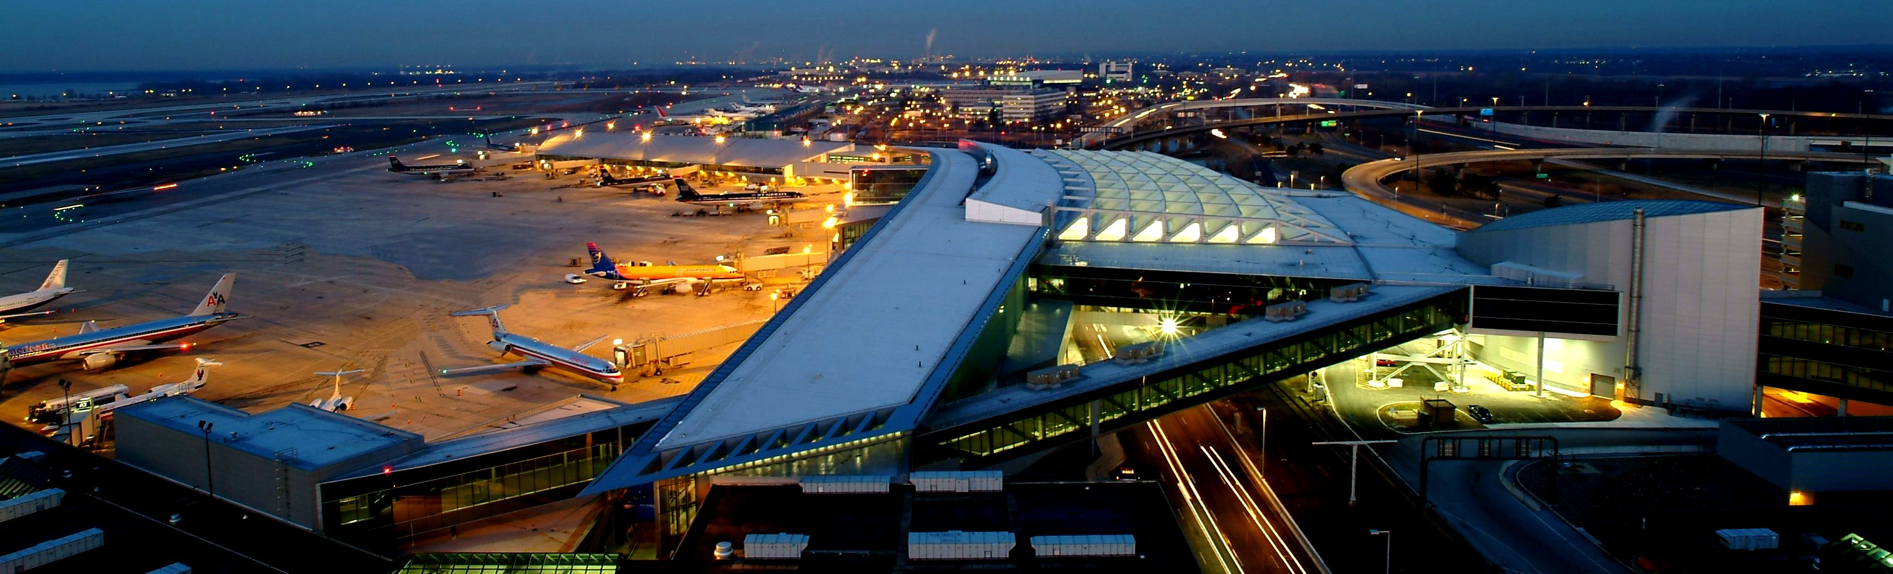
Why Airports are Ideal Locations for Resilient Microgrids
Large 24/7/365 energy users
Critical transportation infrastructure
Growing energy requirements (before COVID)
Looking for Cost reductions
Carbon reduction goals
Need for Resiliency
Speaker: Mike Walton, Burns Engineering

Slide 8
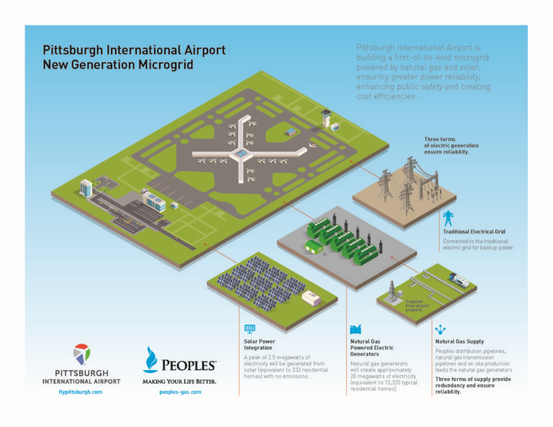
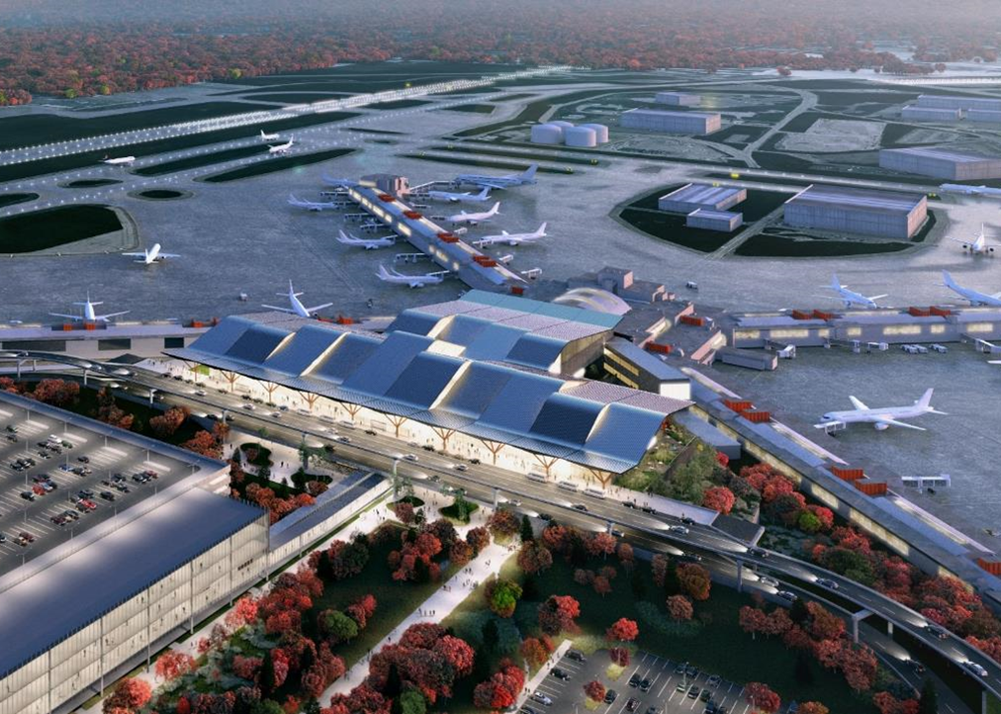
Innovative Airport Microgrid Project at Pittsburgh International Airport
Results #1
Results #2
Results #3
Speaker: Mike Walton, Burns Engineering
8

Slide 9

3) Where and How Electrification will Drive Microgrid Development
Kevin Self, Schneider Electric, SVP Strategy
Challenges:
Automobiles, trucks, buses, incl. fleets are becoming electric
EV infrastructure is a missing link
Efficient, clean, and local power is needed
9

Slide 10
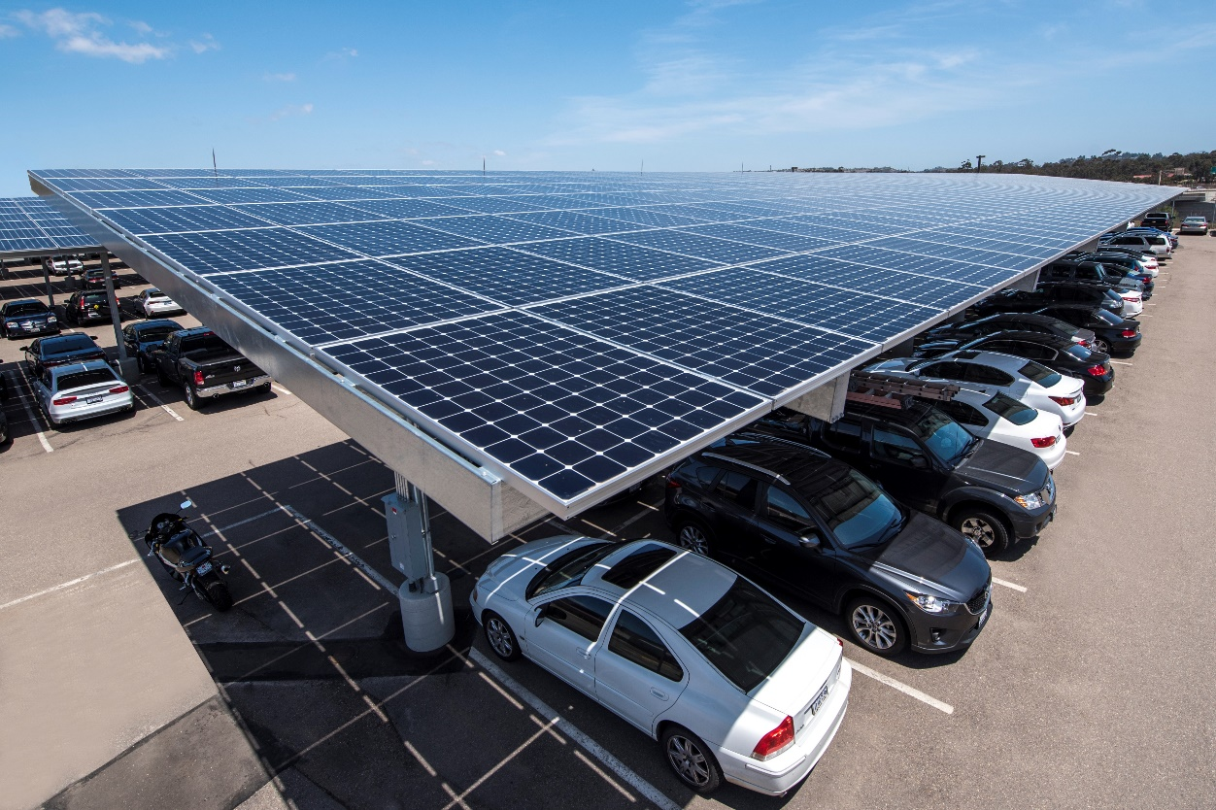
Solutions
Follow a proven process
Address the power, digital, and finance aspects
Address energy costs, resiliency, and sustainability by leveraging a microgrid
Speaker: Kevin Self, Schneider Electric

Slide 11
Results / Recommendations
Feasibility Analysis should be your first step
Investigate EaaS vs utilizing CAPEX (Is it ownership or control you seek?)
Align with partners that can reduce your risk
Speaker: Kevin Self, Schneider Electric
11

Slide 12
Ask the Experts: Q&A Session
Type your questions in to the Q&A box
#MicrogridVirtual

Slide 13

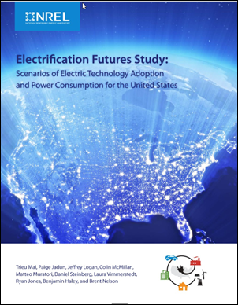
Microgrid Knowledge Virtual Conference Resource Library
Recommended Resources
Microgrid Resource Library
Visit - ThinkMicrogrid.com
Network with the MGK Community on LinkedIn
13

Slide 14

Save the Date: Microgrid 2020 Conference
Nov. 18-20 – Philadelphia, PA
Transportation Session: Electrifying and Microgridding Planes, Trains and Ports
Plus 90 speakers in 30+ sessions on best practices
35 exhibitors
Networking opportunities
14

Slide 15
Thank You!
Next Session: Will COVID-19 Impact Microgrid Policy Progress? @ 3PM Eastern
#MicrogridVirtual

